Slide 1
Bayes Theorem
By Anmol Yaseen

Slide 2
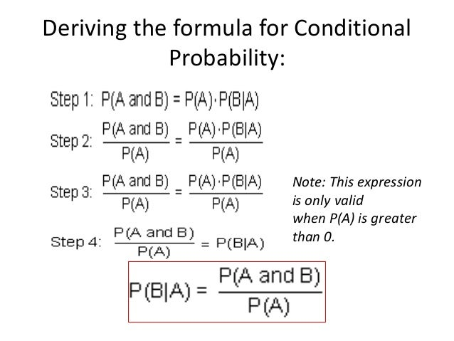
Deriving conditional probability formula
Here’s how to read Bayesian notation:
P(A) means “the probability that A is true.”
P(A|B) means “the probability that A is true given that B is true.”

Slide 3
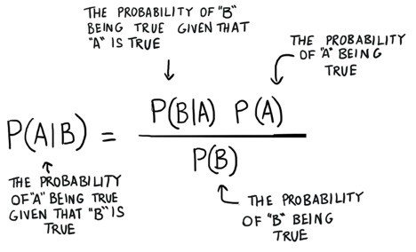
Conditional Probability: Bayes’ Theorem
Conditional probability is the probability for one event to occur with some relationship to one or more other events.
Or it is the measure of likelihood of an event when another event is known to have occurred

